Slide 1
CS143 Discussion Session
Week 7 – ER, FDs and NFs
Jia (Jason) Teoh
(Slides reused from Week 10 review, Spring 2017 and other credited sources)

Slide 2
Announcements
Project 2 is released, due Friday, December 8 @ 11:59 PM
  START EARLY
HW4 released, due Wednesday November 11 @ 11:59PM
Midterms:
  Grades, Solutions on CCLE
  Last regrade opportunity is office hours: 11/22 (Wed) Boelter 2432 1-3PM
Notes:
cannot emphasize enough about starting early
HW4 is 3rd to last homework (2 more after)
address midterm complaints??

Slide 3
Outline
ER Diagram
Functional Dependencies
Normalization
Spark/Project 2
Notes:
Ask about order of topics – Spark first or last?

Slide 4

E-R Diagrams
Rectangles represent entity sets.
Diamonds represent relationship sets.
Lines link attributes to entity sets and entity sets to relationship sets.
Ellipses represent attributes
  Double ellipses represent multivalued attributes.
  Dashed ellipses denote derived attributes.
Underline indicates primary key attributes (will study later)
Notes:
These should be familiar from lecture

Slide 5
Mapping Cardinalities
Express the number of entities to which another entity can be associated via a relationship set.
Most useful in describing binary relationship sets.
For a binary relationship set the mapping cardinality must be one of following types:
  One to one
  One to many
  Many to one
  Many to many

Slide 6

One-To-Many Relationship
In the one-to-many relationship a loan is associated with at most one customer via borrower, a customer is associated with several (including 0) loans via borrower
Notes:
arrow (0 or 1) into customer
regular line (0 or more) to loan:
result: 1 customer per loan, but customer can have multiple loans!

Slide 7
Many-To-One Relationships
Example of many-to-one relationships: a loan is associated with several (including 0) customers via borrower, a customer is associated with at most one loan via borrower
Notes:
What happens if we swap arrow/line? inverted relationship
Now one loan can have multiple customers!
but each customer can only have one loan

Slide 8
Cardinality Constraints
We express cardinality constraints by drawing either a directed line (→), signifying “one,” or an undirected line (—), signifying “many,” between the relationship set and the entity set.
Example of One-to-one relationship:
  A customer is associated with at most one loan via the relationship borrower
  A loan is associated with at most one customer via borrower
Notes:
alternate notations also available
just make sure it's clear on the exam if we have an ER question

Slide 9
Many-To-Many Relationship
Example of Many to Many Relationships:
  A customer is associated with several (possibly 0) loans via borrower
  A loan is associated with several (possibly 0) customers via borrower

Slide 10

Roles
Entity sets of a relationship need not be distinct
The labels “manager” and “worker” are called roles; they specify how employee entities interact via the works-for relationship set.
Roles are indicated in E-R diagrams by labeling the lines that connect diamonds to rectangles. Directed line (→): Cardinality Constraints
Role labels are optional, and are used to clarify semantics of the relationship
Notes:
similar to how we might self-join in SQL

Slide 11

Weak Entity Sets
We depict a weak entity set by double rectangles.
We underline the discriminator of a weak entity set with a dashed line.
payment-number – discriminator of the payment entity set
Primary key for payment – (loan-number, payment-number)
Notes:
weak entity - dependent on a (strong) entity to be uniquely identified
the 'key' is somewhat partial, needs to be combined with another entity's

Slide 12
Specialization
Top-down design process; we designate subgroupings within an entity set that are distinctive from other entities in the set.
These subgroupings become lower-level entity sets that have attributes or participate in relationships that do not apply to the higher-level entity set.
Depicted by a triangle component labeled ISA (E.g. customer “is a” person).
Attribute inheritance – a lower-level entity set inherits all the attributes and relationship participation of the higher-level entity set to which it is linked.
Notes:
Generalization also uses ISA relationship!
not too different from class inheritance in PL

Slide 13


Slide 14

Summary of Symbols Used in E-R Notation

Slide 15
Summary of Symbols (Cont.)

Slide 16
Functional Dependencies and Normal Forms

Slide 17
Functional Dependencies
Let X= {A₁, ..., A_{n}}, and Y={B₁, ..., B_{m}} be subsets of the attributes in R(W):
We say that Y is functionally dependent on X and write
X -> Y when
For every pair of tuples u1, u2 in R,
if u1[X] = u2[X], then u1[Y] = u2[Y] –
No two tuples in R can have the same X values but different Y values!
Given R(W), let Z be a subset of W where Z -> W, then Z is said to be a key for R(W)
Trivial FD: X -> Y where Y is a subset of X.
Notes:
X,Y are attributes or sets of attributes

Slide 18
FDs’ Properties
Reflexivity: If Y is a nonempty subset of X then
X -> Y.
Augmentation: if X -> Y and X is a subset of Z, then Z->Y
Transitivity: X -> Y and Y->Z then X->Z
This is a sound and complete set of inference rules.
  Every other sound properties can be derived from these.

Slide 19
About FDs
A | B | C
a1 | b1 | c1
a1 | b2 | c2
a2 | b1 | c3
Does this FD hold?
AB -> C – Yes (Given only this instance)
Here we have replaced a2 with a1
Does this FD hold?
AB -> C – No: does a1,b1→ c1 or c3?
A | B | C
a1 | b1 | c1
a1 | b2 | c2
a1 | b1 | c3
Since the content of tables change in the DB, we are only interested
in those that hold all the time since they result from integrity constraints that hold in the real world!
Also important: A -> BD iff A ->B and A->D

Slide 20
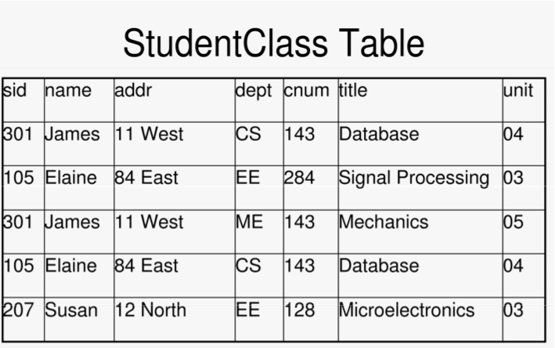
FDs here: sid -> name sid -> addr
dept, cnum -> title, unit
FDs here are the source of redundancy & update anomalies
Notes:
redundancy: eg addr and name are stored multiple times for each sid.

Slide 21
Only certain FD patterns are a problem. For instance consider two projections of the previous table
LeftTable
RightTable
sid | name | addr
301 | James | 11 West
105 | Elaine | 84 East
207 | Susan | 12 North
dept | cnum | title | unit
CS | 143 | Databases | 04
EE | 284 | Signal Processing | 05
ME | 143 | Mechanics | 03
EE | 128 | Microeletronics | 04
Same FDs here: sid -> name …in LeftTable
sid -> addr
dept, cnum -> title, unit …in RightTable
In the old table these FDs were the source of redundancy & update anomalies
As in the original table
But no redundancy or update anomaly here! Why?
…Because sid is the key for LeftTable & dept, cnum is the key for the right table!

Slide 22
Understanding NFs
1NF: flat tables: no structured fields
2NF: Relations are 2NF when they are 1NF and no non-key attribute is partially FD on a key (ie FD on a subset of key)
3NF: Relations are 3NF when they are 2NF and and no non-key attribute is transitively FD on a key
BCNF: Relations are BCNF if for every non-trivial X->A,
X is a key or a superset of a key
Revisiting the definition of 3NF
Definition: R is 3NF iff for every non-trivial X -> A, either
(i) X is a key or a superset of a key, or
(ii) A is an attribute of some key
. (which will be broken if we decompose since A will go into one projection and the remaining key attributes into the other)
Notes:
alternate definitions provided later too – there are many ways to view these (esp 3NF and BCNF) and it’s mostly important to find one that makes sense to you.
Small clarification: “key” generally refers to “candidate key”. Normally “key” means any combination of attributes that can be used to identify an entire tuple. “candidate key” is a key such that no subset of the candidate key is itself a key (eg if AC is a candidate key, neither A nor C are keys).
superset of key is generally just a candidate key + additional attributes. Note this trivially includes all the attributes in a relation.

Slide 23
Violation of the 2NF requirement
dpchair | dept | cnum | title | unit
Tom | CS | 143 | Databases | 04
Eddy | EE | 284 | Signal Processing | 05
Nancy | ME | 143 | Mechanics | 03
Eddy | EE | 128 | Microeletronics | 04
What are the FDs here?: dept -> dpchair dpchair is FD on dept
dept, cnum -> title, unit
What is the key here: dept, cnum
Thus dpchair is FD on only a subset of the key.
A violation of the 2nd Normal Form requirement.
Decompose into (dept, dpchair) (dept, cnum, title, unit)

Slide 24
Violation on 3NF: Transitive FD on Key
sid | Advisor | OfficeNo
301 | James | BH 3551
105 | Elaine | MH 2009
207 | James | BH 3551
Sid-> Advisor
Advisor-> OfficeNo
Then
Sid -> OfficeNo
Key: Sid
Anomalies: ?
Codd’s 3NF: A relation which (i) is in 2NF and (ii) no attribute is transitively dependent on a key.
3NF avoids the anomalies caused by transitive dependencies on keys.
These anomalies can be eliminated by decomposition.
For the case at hand (sid, Advisor) (Advisor, OfficeNo)

Slide 25
A simpler (but stronger) Normal Form
Given a relation R and its FDs:
Keys: X is a KEY of R(W) iff
X -> all attributes of R, i.e. X -> W (i.e. X is a superkey)
No subset of X satisfies 1. i.e. X is minimal
Boyce-Codd Normal Form (BCNF):
R is in BCNF iff for every non-trivial X -> Y, X contains a key (i.e. it is a superkey)
X->Y is trivial if Y is a subset of X: e.g. A,B ->B is trivial—i.e., it is not a real constraint since it holds in all tables

Slide 26
BCNF Continued
Informally: “Each attribute must represent a fact about the key, the whole key, and nothing but the key.”
  http://www.vertabelo.com/blog/technical-articles/boyce-codd-normal-form-bcnf

Slide 27
Now consider the projections of StudentClass
LeftTable
RightTable
sid | name | addr
301 | James | 11 West
105 | Elaine | 84East
207 | Susan | 12 North
dept | cnum | title | unit
CS | 143 | Databases | 04
EE | 284 | Signal Processing | 05
ME | 143 | Mechanics | 03
EE | 128 | Microeletronics | 04
FDs in LeftTable: sid-> name sid the key in LeftTable: sid-> addr no BCNF violation
FDs in RightTable: dept, cnum -> title (dept, cnum) is the key: dept, cnum ->unit no BCNF violation
Therefore …
(1) The original relation was not BCNF, but
(2) The two projections are in BCNF
(3) But these two projections are not enough: we need lossless decomposition.

Slide 28
Practice (Berkeley Sp’16 Final)
Consider the relation R(A, B, C, D), with functional dependency set F:
{AB→C, BC→D, CD→A, AD→B, C→BD}. Which of the following is/are true?
C is a candidate key of R.
D is a candidate key of R.
AB is a candidate key of R.
R is in BCNF.
Answer: A, C, D
Notes:
https://hkn.eecs.berkeley.edu/examfiles/cs186_sp16_f.pdf
https://hkn.eecs.berkeley.edu/examfiles/cs186_sp16_f_sol.pdf
a: C -> BD gives {B,C,D}. But we also have CD->A, which gives us all attributes
b: D alone gives nothing, so we only have {D}. Not the entire relation, thus not a key.
d: AB->C gives {A,B,C}. BC->D gives the remaining D, hence the key.
d: BCNF: From parts a and c we know that C and AB are candidate keys. Thus:
AB->C; AB is a candidate key
BC->D; BC is a superset of C, which is a candidate key.
CD -> A; CD is also a superset of C
AD -> B; AD happens to be another candidate key: AD -> B gives us {A,B,D}, after which we can get C via AB->C.
C -> BD; C is a candidate key

Slide 29
Lossless Decomposition
Take a relation R(W) where W= X U Y U Z and replace it with:
R₁= π _{X U Y} R(W) and R₂= π _{X U Z} R(W)
Theorem: If X-> Y or X->Z then R(W) can be reconstructed as the natural join of these two projections.
By repeating this step we generate a set of relations that are BCNF and whose natural join return the original table (a lossless decomposition)
Notes:
Lossless decomposition means no information is lost; in a lossy decomposition, the original records in the table are still there but we may add additional records (ie the original information about the tables is lost).
Records themselves aren’t actually lost!

Slide 30
Decomposition into BCNF
Given a relation R, we find its FDs
From these we find the keys, then we ask the question: is R in BCNF?
  If the answer is yes, we smile.
  If the answer is no: we decompose the original relation into a set of BCNF tables
The decomposition algorithm is based on the notion of cover (closure), which is based on the formal properties of FDs.
Three objectives: (1) Lossless decomposition, (2) FD preservation (3) minimal relation count.

Slide 31
Given R(W): Check or Derive BCNF
All the FDs must be Elementary: i.e.
  Their right side must contain only one attribute and this is not contained in the left side
  Their left side must be minimal
For each left-side X check if this is a key by computing X⁺
  If X⁺=W then X is a key. The FDs with this left side create no problem.
  If X⁺ is a subset of W you must decompose into a pair with attributes X⁺ and
  X⁺ U (W - X⁺) U X.
Repeat until BCNF is reached.
Notes:
Removed/rewritten because it’s a bit confusing

Slide 32
Decomposing into BCNF
For each nontrivial FD X->Y in R(W):
  If X is a superkey (X⁺ = W), nothing to do.
  Otherwise X->Y violates BCNF:
    Decompose R to R₁(X⁺) and R₂(X U (R – X⁺))
      R₁ = all attributes in X->Y closure
      R₂ = all the other attributes, plus original X
    Recurse on both R₁ and R₂ and their corresponding FDs
Notes:
At least for Jason’s undergrad, BCNF was important on exams!

Slide 33
BCNF Decomposition (pseudocode)
Initialize S = {R}
While S has a relation R' that is not in BCNF do:
  Pick a FD: X->Y that holds in R' and violates BCNF (X != superkey)
  Add the relation XY to S
  Update R' = R'-Y
Return S
credit: https://stackoverflow.com/a/18399094/6890456
Notes:
SO post is also a reply to an actual example if you’re interested

Slide 34
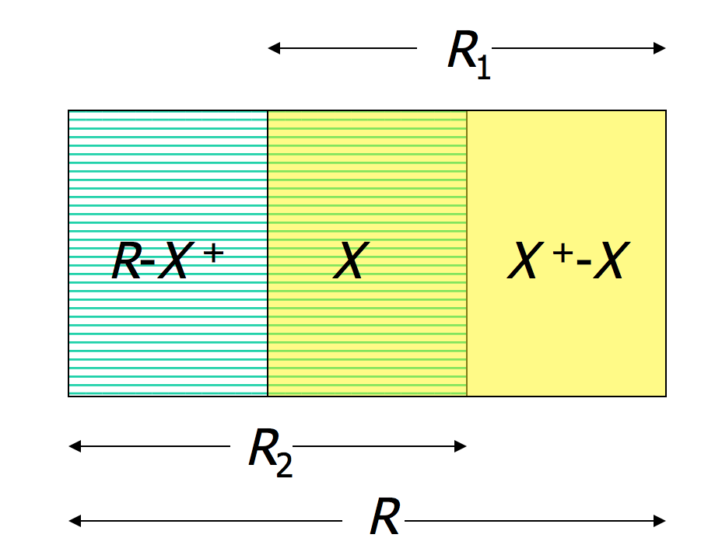
BCNF Decomposition
credit: http://imada.sdu.dk/~petersk/DM505/slides/slides6.pdf
Notes:
Assuming FD ”X->Y” violated BCNF on relation R

Slide 35
Practice (Berkeley Sp’15 MT2)
Given the attribute set R = ABCDEFGH and the functional dependency set F = {BC→GH, AD→E, A→H,E →BCF, G→H}, decompose R into BCNF by decomposing in the order of the given functional dependencies.
Answer: ADE, BCEF, GH, BCG
Notes:
Almost the end – if not enough time, just show solution and have students go through example on their own.
https://hkn.eecs.berkeley.edu/examfiles/cs186_sp15_mt2.pdf
https://hkn.eecs.berkeley.edu/examfiles/cs186_sp15_mt2_sol.pdf
Idea: for each LH you want to identify the full closure...
BC -> {BCGH}
AD: {ADEHBCFGH} (roughly in order) -> all!
A : {AH}
E: {EBCFGH} (missing A, D)
G: {GH}
We go in order: BC->GH violates bc BC is not a key
Result: ABCDEF (removed GH), BCGH
Next we look at AD-> E: it was a key of the initial relation, so it must also be a key of the ABCDEF relation. no need to do anything
A -> H: Does not apply because no relation contains A and H. If you were keeping track of which FDs apply to which relation, you’d notice we ‘lost’ this one.
E->BCF: this only applies to the first relation (ABCDEF) and is unable to provide A or D (only EBCF) so it violates BCNF as it is not a superkey
Result: ADE, EBCF, BCGH (unchanged)
G->H: this only applies to the last relation (BCGH) and G is not a superkey, so we need to decompose:
Result: ADE (unchanged), EBCF (unchanged), GH, BCG
Final: ADE, EBCF, GH, BCG

Slide 36
BCNF vs 3NF (X->Y)
BCNF: X must be a superkey
3NF: X is superkey or Y is prime (member of a key)
Example:
  R(A,B,C); FDs = {AB->C, C->B}
  Two possible (minimal) keys: AB, AC
  C->B violates BCNF (C is not a superkey)
    doesn’t violate 3NF
  BCNF decomposes to AC, CB
  But then we lose AB->C (no dependency preservation)
Takeaway:
  3NF provides both lossless join and dependency preservation.
  BCNF can’t always guarantee both
Notes:
AB key comes from FD. AC works because C->B, so C+ = {C, B}. You just need to add A to cover the whole relation.

